Slide 1
Machine Learning Fundamentals

Slide 2
Learning Goals
Essential Question:
What is learning?
What are neural networks?
How do neural networks work?
What is training in Machine Learning?
You will be able to:
Describe the parts of a neural network.
Explain what a neural network does.

Slide 3
Learning

Slide 4
A Quick Note
Clustering: Grouping data based on statistical similarity. In ML a useful clustering scheme may not be known and it is then the models job to find a useful clustering scheme
Dimensionality Reduction: Compressing data such that it can be represented in fewer dimensions, ideally without losing information
Label: The correct or expected response from the model
Classification: Clustering data into classes, such as cats and dogs, using labeled data. ML models classify data by predicting discrete values such as 'dog' or 'cat' with a certainty
Regression: Predicting continuous values, such as housing price, using labeled data

Slide 5
What You Know
What is Learning?
Learning can be defined as:
The process of updating what you know to make better decisions
In ML there are currently 4 learning paradigms
Supervised Learning
Unsupervised Learning
Semi-supervised Learning
Reinforcement Learning
3
Decision Process
1
Action
2
What you know is processed to make a decision
An action is taken according to the decision
The result of the action is evaluated and what you know is updated

Slide 6
Dataset
Supervised Learning
Data has Labels which provide feedback to the model
Used for Regression and Classification
One of the most popular learning paradigms
Assumes correlation between inputs and outputs
Has been used for:
House Price Prediction
Face Recognition
Virtual Assistants (Siri, Alexa)
3
ML Model
1
Result
2
Regression and Classification
The ML model is given data
The model computes a prediction
The result is evaluated and used to update the model

Slide 7
Unsupervised Learning
Dataset
Result 2
Data is Unlabeled and no direct feedback is provided to the model
Used for Clustering and Dimensionality Reduction
Not as commonly used as supervised learning
Has been used for:
Synthetic Data Generation
Grouping / Clustering data
4
ML Decoder
3
5
ML Encoder
1
2
Dimensionality Reduction
A ML model (encoder) is given data
The model reduces the dimension
The encoder output is given to a second model (decoder)
The decoder attempts to recreate the input data
The result is evaluated and both models are updated
Result 1

Slide 8
Dataset
Semi-supervised Learning
Uses both labeled and unlabeled data
Combines the supervised and unsupervised paradigms
Used for Regression and Classification
Has been used for:
Speech Analysis
Internet Content Classification
Protein Sequence Classification
3
ML Model
1
Result
2
Regression and Classification
The ML model is given data
The model computes a prediction
The result from labeled data is evaluated and the model is updated; otherwise, the unlabeled data is labeled

Slide 9
Reinforcement Learning
A learning paradigm in which an agent explores an environment to learn a policy
Consider a human navigating a maze.
The agent is the human
The environment is the maze
The policy is the human’s plan
Has been used for:
Playing games (Atari, go, chess)
ChatGPT
2
ML Model
Result
1
The model makes a decision in the environment
The action is taken, the result is evaluated, and the model is updated

Slide 10
Neural Networks

Slide 11
What is a Neural Network?
Neural Networks:
Are a model architecture common in ML
Are computational graphs
Find patterns in data
Save calculations that find those patterns
Can be updated to find different solutions to one problem
Are only as good as the data used to create them
Computer Science
Artificial Intelligence
Machine Learning
Neural Networks

Slide 12
Parts of a Neural Network
Weighted Connection
Neuron 1
Neuron 2
Output 1
Input
Output 2
Input
Output n
Input Layer
Hidden Layers
Output Layer

Slide 13
Parts of a Neural Network
Neuron: Given an input it performs a computation and outputs a number.
Layer: A group of neurons which process data at the same time.
Weighted connection
Hidden Layer 2
Neuron
Neuron
Output Layer
Hidden Layer 1
Hidden Layer 3
Output 1
Input Layer
Input 1
Output 2
Input n
Output n

Slide 14
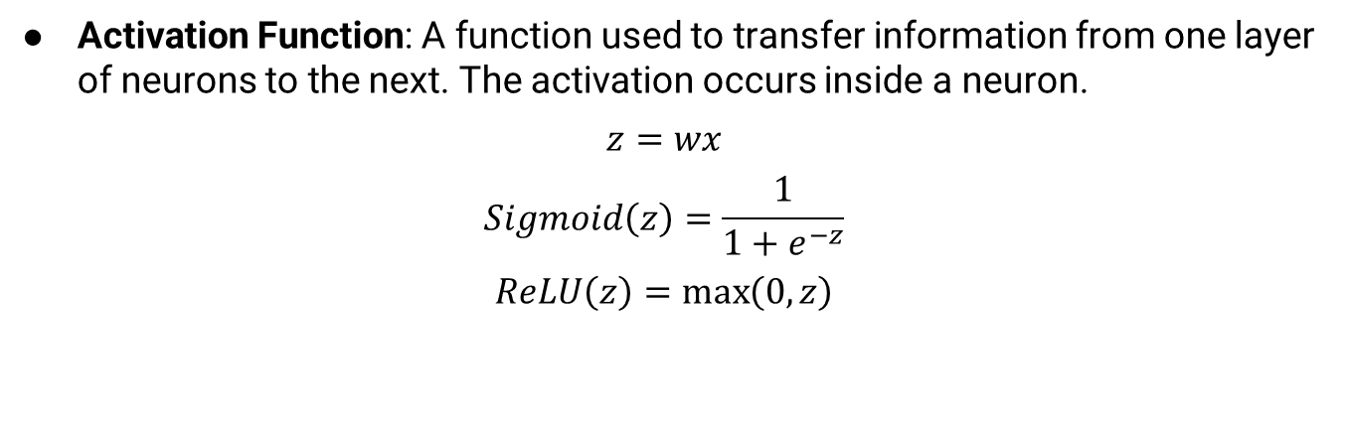
Parts of a Neural Network
Activation Function: A function used to transfer information from one layer of neurons to the next. The activation occurs inside a neuron.
$$z=wx$$
$$Sigmoid\left(z\right)=\frac{1}{1+e^{−z}}$$
$$ReLU\left(z\right)=\max\left(0,z\right)$$
Weighted connection
Neuron
Neuron
Output 1
Input Layer
Input 1
Output 2
Input n
Output n

Slide 15
Parts of a Neural Network
Input layer: The layer which receives data. The data may be pixel values from images, words from a body of text, a robots sensor information, etc.
Weighted connection
Neuron
Neuron
Output Layer
Output 1
Input Layer
Input 1
Output 2
Input n
Output n

Slide 16
Parts of a Neural Network
Output layer: The layer which presents the prediction. A prediction may be the classification of an image, a new image, the most likely next word in a sentence, the input to a robots control loop, etc.
Weighted connection
Hidden Layer 2
Neuron
Neuron
Output Layer
Hidden Layer 1
Hidden Layer 3
Output 1
Input 1
Output 2
Input n
Output n

Slide 17
Parts of a Neural Network
Hidden layers: All the layers between the input and the output layers. These layers are hidden because we do not directly observe what they learn but a new branch of AI called “Explainable AI” is attempting to solve this.
Weighted connection
Hidden Layer 2
Neuron
Neuron
Hidden Layer 3
Hidden Layer 1
Output 1
Input 1
Output 2
Input n
Output n

Slide 18
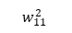
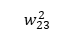
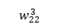
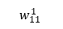
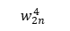
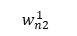
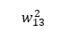
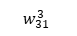
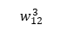
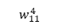
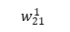
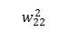
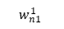
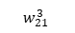
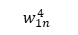
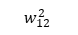
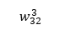
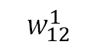
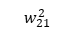
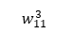
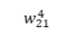
Parts of a Neural Network
Weights: Variables used to adjust the output of the network during training.
Layer
Weighted connection
$$w_{12}^{1}$$
Sending Neuron
Receiving Neuron
Neuron
Neuron
$$w_{11}^{2}$$
$$w_{11}^{1}$$
$$w_{21}^{2}$$
$$w_{11}^{3}$$
$$w_{21}^{3}$$
$$w_{21}^{1}$$
$$w_{12}^{2}$$
$$w_{31}^{3}$$
$$w_{11}^{4}$$
Input 1
Output 1
$$w_{n1}^{1}$$
$$w_{22}^{2}$$
$$w_{12}^{3}$$
$$w_{21}^{4}$$
$$w_{22}^{3}$$
$$w_{n2}^{1}$$
$$w_{13}^{2}$$
$$w_{32}^{3}$$
$$w_{23}^{2}$$
$$w_{1n}^{4}$$
Input n
Output n
$$w_{2n}^{4}$$

Slide 19
Parts of a Neural Network
Neural Network: A collection of layers trained to solve a problem. Most networks have at least one input layer, one output layer, and several Hidden Layers; however, network complexity varies with the problem being solved.
Weighted connection
Neuron
Neuron
Neural Network
Output 1
Input
Output 2
Output 3

Slide 20
Check for Understanding
Can you answer these questions?
How does a neural network work?
What do the different parts of a neural network do?
Neuron
Input layer
Output layer
Hidden layers

Slide 21
Training

Slide 22
Training Terminology
Iteration: A single time the model is presented with an input example.
Epoch: A single time the model is presented with all input training data.
Batch: A group of inputs presented to the network before weight updates are propagated
Forward Pass: The computations required to pass an input through the network
Backpropagation: Propagation of gradients from the outputs to the inputs of a neural network. The fundamental algorithm behind training neural networks
Backward Pass: The computations required to propagate the gradients from output to input
Error/Loss: A metric used to measure the difference between the expected output and the model's output

Slide 23
Supervised Training

Slide 24
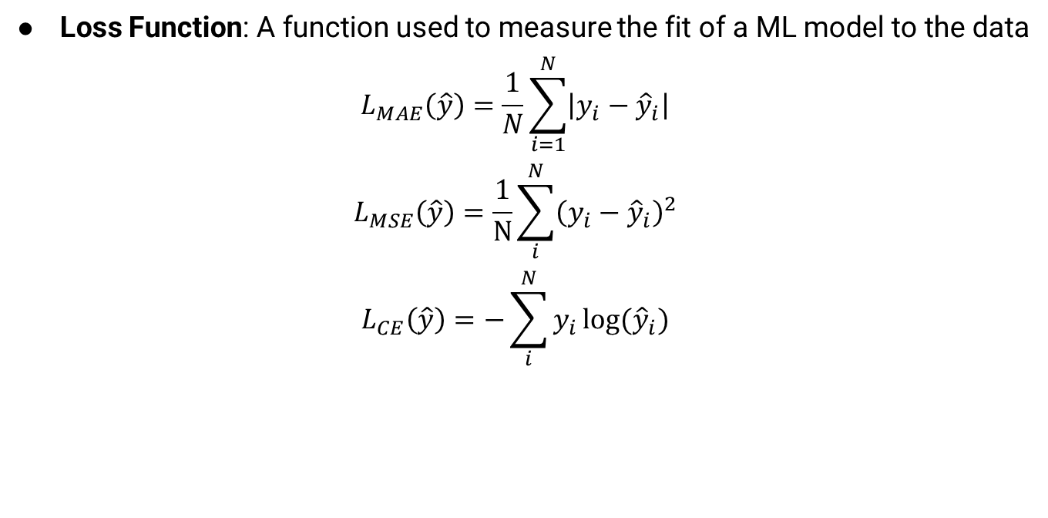
Loss Functions
Loss Function: A function used to measure the fit of a ML model to the data
$$L_{MAE}\left(\hat{y}\right)=\frac{1}{N}\sum_{i=1}^{N}{\left|y_{i}−{\hat{y}}_{i}\right|}$$
$$L_{MSE}\left(\hat{y}\right)=\frac{1}{N}\sum_{i}^{N}{{\left(y_{i}−{\hat{y}}_{i}\right)}^{2}}$$
$$L_{CE}\left(\hat{y}\right)=−\sum_{i}^{N}{y_{i}\log{({\hat{y}}_{i})}}$$

Slide 25
Optimizers
Optimizer: An algorithm used to update the ML model weights. Common optimizers include Stochastic Gradient Descent (SGD), Adaptive Momentum (Adam), Root Mean Squared Propagation (RMSProp)

Slide 26
Training
Training: A cyclical process from which a network learns
Data
Neural Network
Prediction
1
2
3
1
First, an example input is passed to the neural network.
4
Loss Function

Slide 27
Training
Training: A cyclical process from which a network learns
Data
Neural Network
Prediction
1
2
3
2
Second, the neural network computes a prediction
4
Loss Function

Slide 28
Training
Training: A cyclical process from which a network learns
Data
Neural Network
Prediction
1
2
3
3
Third, the prediction is compared with the label by the loss function
4
Loss Function

Slide 29
Training
Training: A cyclical process from which a network learns
Data
Neural Network
Prediction
1
2
3
4
Fourth, the loss is used by the optimizer to update the model weights.
4
Loss Function

Slide 30
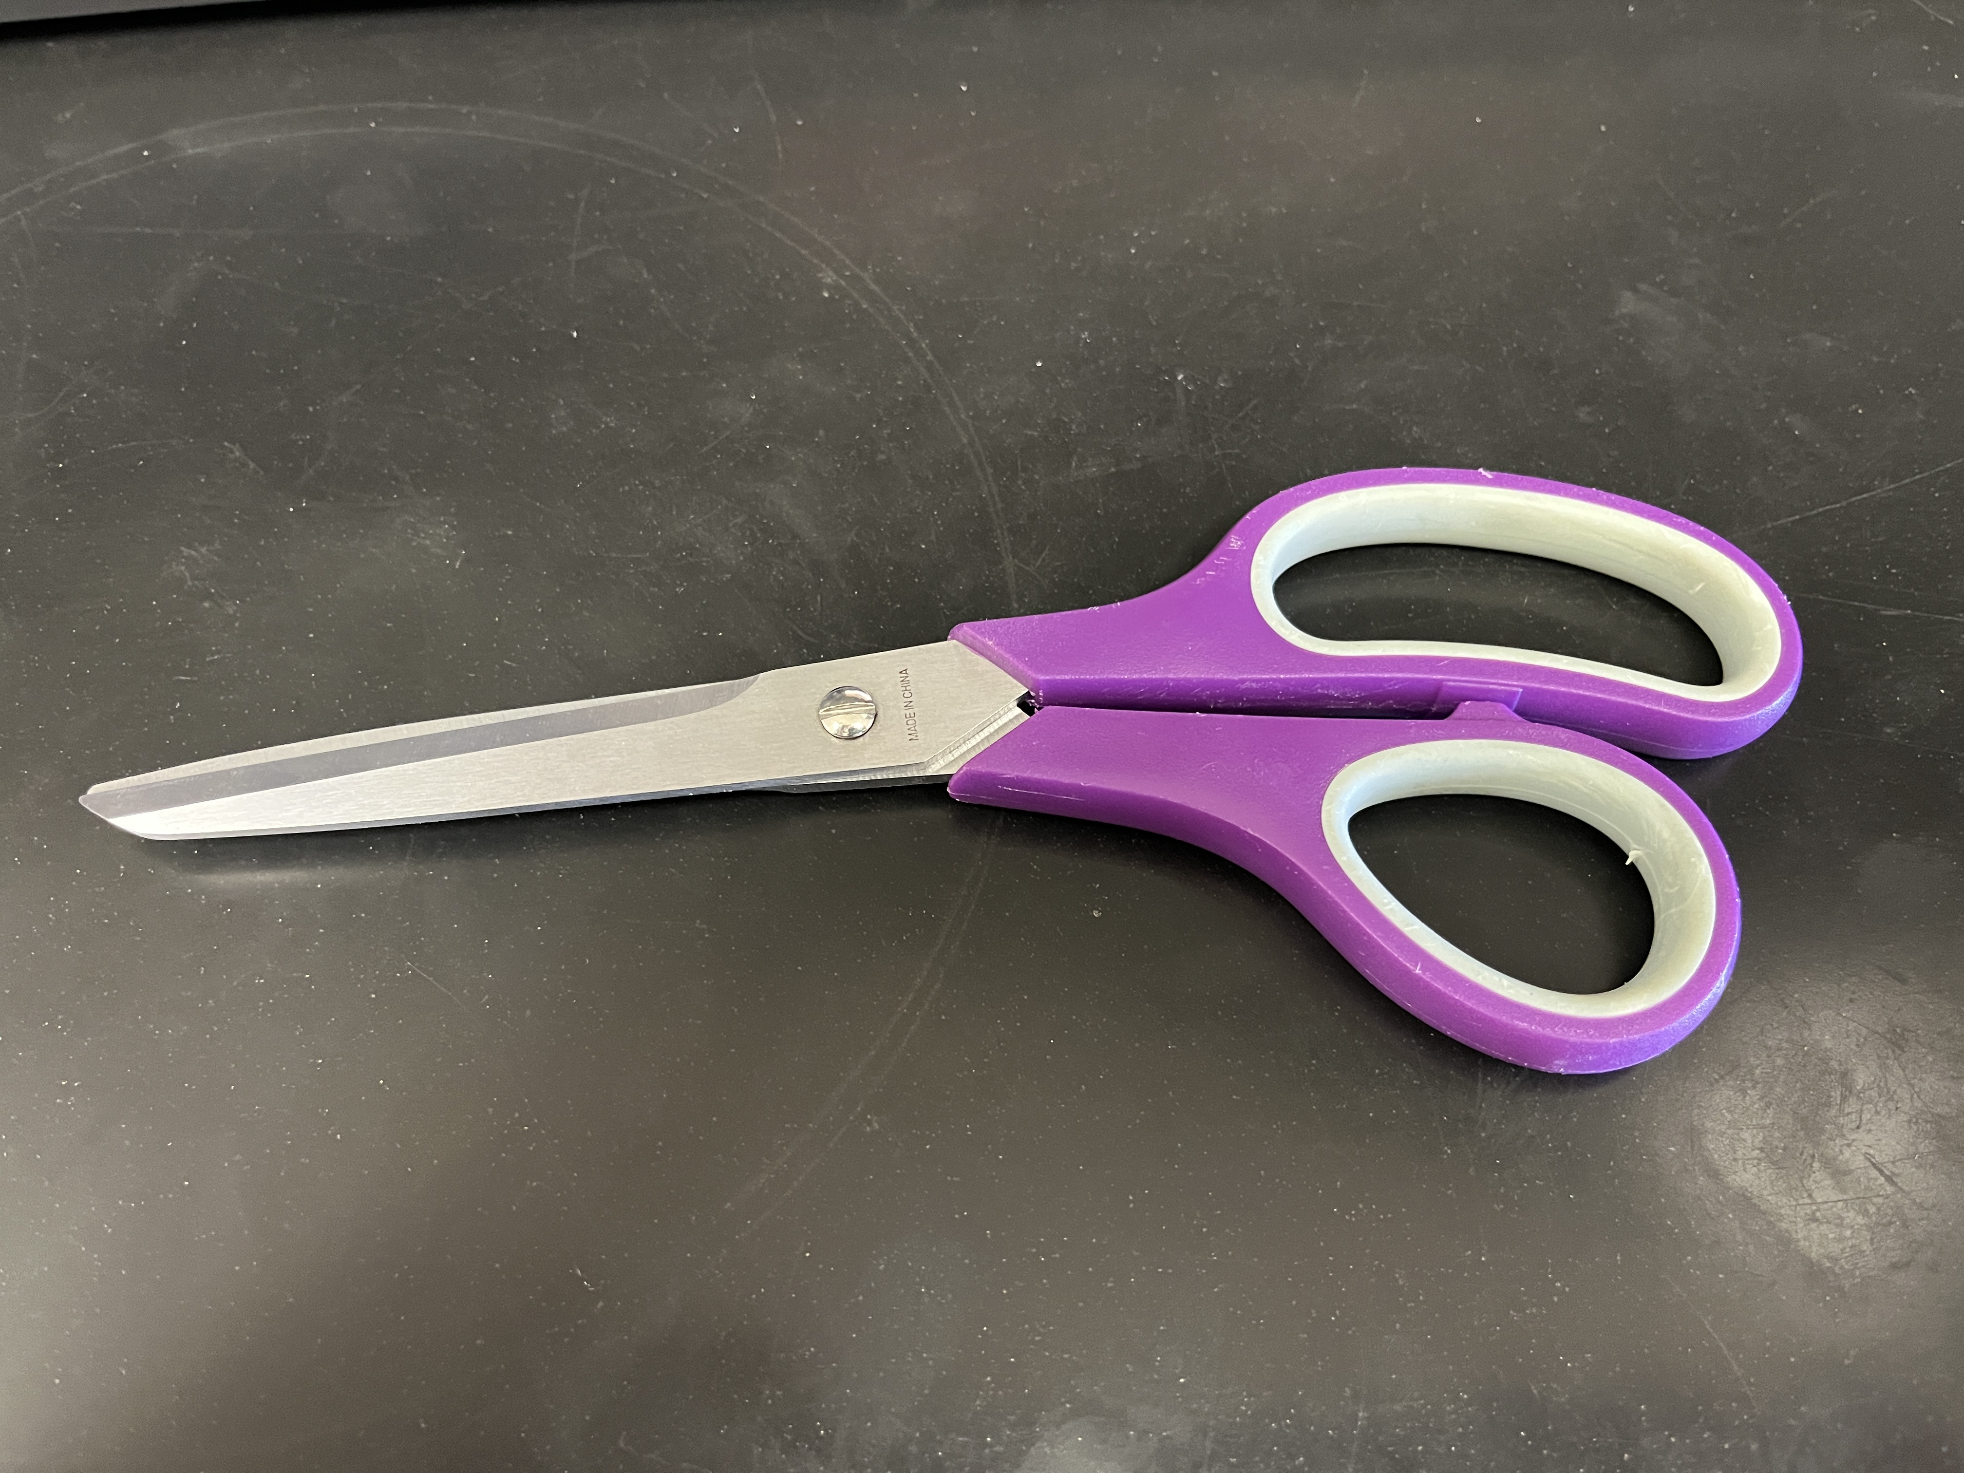
Terminology
Data: A collection of information in a format which can be analyzed by a neural network. This can be images, numbers, strings, characters, etc.
Label: The answer which will be considered as the correct prediction from the neural network. This can be numbers, strings, characters, etc.
Data
Scissors
Labels
Label: 1
Label: 2

Slide 31
Terminology
Dataset: A collection of data and corresponding labels when applicable
Dataset

Slide 32
Terminology
Training Dataset: A subset of the dataset. The training dataset is used to adjust the weights in the network and is usually a large portion of the dataset, 70 to 80%
Dataset
Training Dataset

Slide 33
Terminology
Validation Dataset: A subset of the dataset. The validation dataset is used during training to constrain weights, prevent overfit, and to demonstrate the network is learning. This dataset is not required to train but can provide useful insight into how well the network is suited to the problem, 10 to 20%
Dataset
Training Dataset
Validation Dataset

Slide 34
Terminology
Test Dataset: A small subset of the dataset. The test dataset is used after training to demonstrate the performance of the network, 10 to 20%
Dataset
Training Dataset
Validation Dataset
Testing Dataset

Slide 35
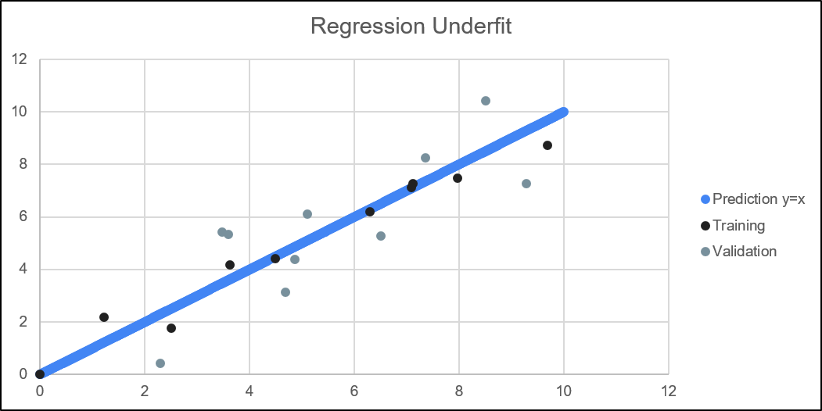
Terminology
Underfit: When the model is not complex enough to learn the necessary information from the data. Characterized by high training and validation loss

Slide 36
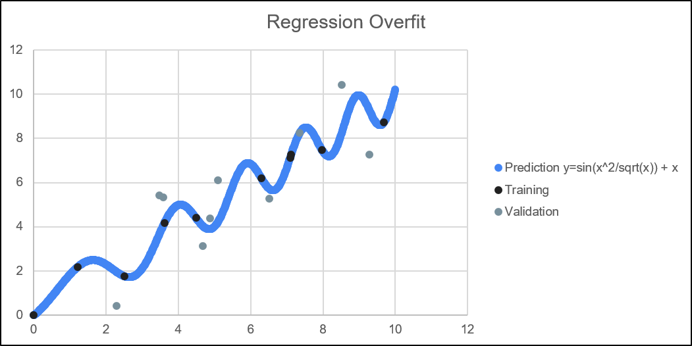
Terminology
Overfit: When the model is trained long enough to memorize the training dataset. Characterized by training and validation loss or accuracy divergence

Slide 37
Check for Understanding
Can you answer these questions?
What is neural network training?
How does neural network training work?
What is each of the following datasets used for?
Training dataset
Validation dataset
Test dataset

Slide 38
Activity

Slide 39
Manual Neural Network
Write a number in the range [0-9] in the provided box
Compare the shape of your number with the activation chart for layer 1 (Input Layer) of the neural network. If the shape is present (or closely present) in your number, mark that neuron as activated
Compare your list of activated neurons for layer 1 (Input Layer) with the requirements for activation in layer 2
Compare your list of activated neurons for layer 2 (Hidden Layer) with the requirements for activation in layer 3 (Output Layer)

Slide 40
Input Layer
Layer 1
a
b
c
d
e
f
g
h
i
j
k
l
m
n
o
p
Layer 2
a
b
c
d
e
f
g
h
i
j
k
l
Layer 3
0
1
2
3
4
5
6
7
8
9
Output Layer

Slide 41
Input:
a
b
c
d
e
f
g
h
i
j
k
l
m
n
o
p
a
b
c
d
e
f
g
h
i
j
k
l
0
1
2
3
4
5
6
7
8
9
Output: 0

Slide 42
Input:
a
b
c
d
e
f
g
h
i
j
k
l
m
n
o
p
a
b
c
d
e
f
g
h
i
j
k
l
0
1
2
3
4
5
6
7
8
9
Output: 2

Slide 43
Input:
a
b
c
d
e
f
g
h
i
j
k
l
m
n
o
p
a
b
c
d
e
f
g
h
i
j
k
l
0
1
2
3
4
5
6
7
8
9
Output: 4

Slide 44
Manual Neural Network
Write a number in the range [0-9] in the provided box.
Compare the shape of your number with the activation chart for layer 1 (Input Layer) of the neural network. If the shape is present (or closely present) in your number, mark that neuron as activated.
Compare your list of activated neurons for layer 1 (Input Layer) with the requirements for activation in layer 2.
Compare your list of activated neurons for layer 2 (Hidden Layer) with the requirements for activation in layer 3 (Output Layer).

Slide 45
DISCUSSION
Discuss the following questions with your neighbor
What did the neural net do well?
What did the neural net do poorly?
How could we improve the performance if we did this again?

Slide 46
AI in the Real World

Slide 47

AI & Art
Matthew Kenney
Senior Machine Learning Engineer at Apple
Instructed at Duke on AI & Art and Data Science
Experimented with GAN newscasters and changing one face into another
Built generative soundscapes and experimental architectures and forms
Mentored students in Web design
Education
Masters in New Media from Penn State
B.S. at Cornell University

Slide 48

AI & Art
Lia Coleman
Adjunct Professor at Rhode Island School of Design
Instructor at Artificial Images
Creative Director at Excel Mandarin
Creates AI generated video synced with audio
This is the same technology that gets used to make deepfakes
Uses art to teach Mandarin
Wrote a field guide on responsible AI in Art
Worked as a machine learning engineer at Facebook
Education
B.S. in Computer Science at MIT

Slide 49
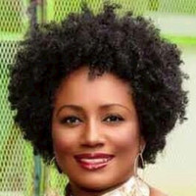
AI & Criminology
Renée Cummings
Data Activist in Residence, University of Virginia
Founder & CEO, Urban AI
Founder & CEO, Criminal Justice Intelligence, Inc
Founding Board member of AI & Ethics Journal
Specializes in ethical AI, reducing bias, using AI for social good and reducing homicides
Education
Masters of Arts, Criminal Justice, John Jay College
Masters of Science Rehabilitation Science and Substance Abuse Counseling, Hunter College
Bachelors in Political Science, Philosophy, Media Science, Creative Writing at Hunter College
Certificate in AI Law from Practicing Law Institute

Slide 50

AI & Education
Yim Register
Ph.D. Student at University of Washington
Is non-binary and uses they/them pronouns; autistic
Researches with Emma Spiro at UW iSchool.
Studies self-advocacy and Machine Learning Literacy (created the activity from earlier)
Member of the MD4SG Data Economies working group, which studies access to and use of data
Other experience: court-appointed child advocate, co-founded a group to teach data science to under-represented groups
Education:
B.S. in Cognitive Science with a focus in AI at University of Rochester

Slide 51

AI & Medicine
Daphne Koller
Founder and CEO, Insitro
Insitro uses machine learning to test molecules.
Find patterns in lots of data using Neural Networks
Worked for Calico - Google’s extension-of-life branch
Co-founder of Coursera and Engageli, both platforms to share college content online
Education
PhD at Stanford
BSc & MSc at Hebrew University in Jerusalem

Slide 52

AI & Medicine
Ehi Nosakhare
Machine Learning Scientist at Microsoft
Works on using ML to improve Microsoft products
Powerpoint suggests possible styles for your slides, and will redesign for you
Deciding what news you’d like to read
PhD research in using machine learning finding patterns in health data to help people plan their healthcare plans
Education
Ph.D. and M.S. in Electrical Engineering and Computer Science at MIT
B.S. in Electrical Engineering at Howard University

Slide 53
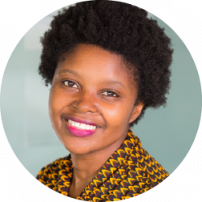
AI & Policy
Mutale Nkonde
Founding CEO of AI For the People, AI Policy Advisor at Berkman Klein Center for Internet & Society
AI for the People uses media to explain to people what biases exist in machine learning
Studying how congressional staffers learn about AI policy at Berkman Klein
AI Policy Advisor for Congresswoman Yvette Clarke when she was part of a team that introduced the Algorithmic Accountability Act, the Deep Fakes Accountability Act, and the No Biometric Barriers to Housing act to the U.S. House of Representatives.
Started as a Broadcast journalist for BBC, CNN & ABC

Slide 54

AI & Law
Gabrielle M. Rejouis
Senior Policy Manager: Color of Change
Co-organizer of the Color of Surveillance: Monitoring of Poor and Working People.
Written articles on surveillance, privacy, equity
Speaks on data privacy, inclusivity
Grew up in a Haitian community and wanted to advocate for her community
Education:
Juris Doctor at Georgetown University Law Center
Bachelor in history with a minor in law at NJIT

Slide 55

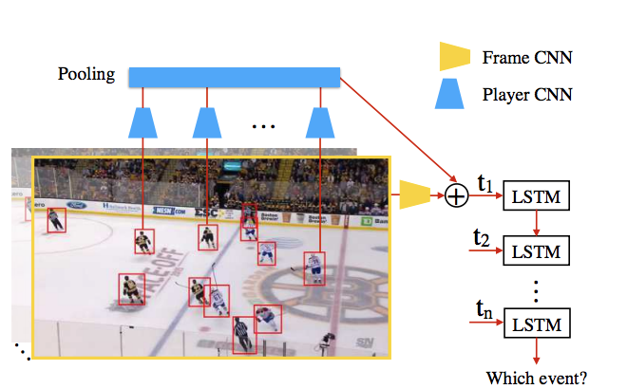
AI & Sports
Moumita Roy Tora et. al.
Researcher
Currently an ML engineer at Xtract AI
Understand what groups of players are doing by watching their interactions
Tested on Hockey
Helps coaches make strategic decisions
Creates highlight reels for specific players
Education
M.S. in CS University of British Columbia
B.S. in CS at Brac University

Slide 56

AI & Social Knowledge
Timnit Gebru
Founder, Black in AI
Former researcher at Google in Ethical AI
Studies algorithmic bias at Microsoft
Designed circuits for Apple
Uses Google Street View data to understand economics in an area
What cars people drive gives information about economic status, voting patterns, and can point out inequality
Education
PhD, MS, and BS in electrical engineering at Stanford

Slide 57
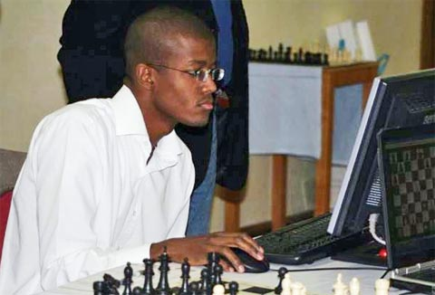
AI & Chess
Anson Williams
Advanced Chess Champion
Telecommunications Engineer / Software Developer
Advanced / Freestyle Chess means you play chess with chess engines, deciding the best move from several choices
Team is called “Integrand”
Won 23 games and lost only 1 of last 52 games he played
Not rated in regular chess
Masters in Electrical Engineering from Imperial College

Slide 58

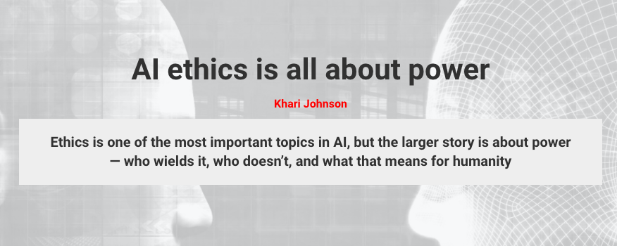
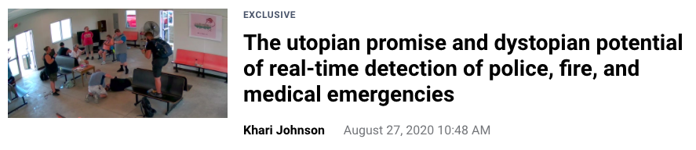
AI & Journalism
Khari Johnson
Senior AI Staff Writer – VentureBeat
Has worked as an editor, video producer, reporter, and community manager
Has reported on tech, politics, education, sports, and business
Education
B.A. in Journalism from San Francisco State University

Slide 59
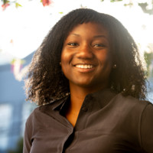
AI & Ethics
Lade Obamehinti
Technical Business Lead, AR/VR & Head of Inclusive AI at Facebook
“Facebook's Inclusive AI team builds and scales solutions for the responsible and ethical development of AI-powered products.”
Past work:
Engineering Program Manager
Education
Bachelor’s in Math, Mechanical Engineering, and Systems Engineering from Southern Methodist University

Slide 60

AI & Astronomy
Brian Nord
Founder and Director of Deep Skies Lab
Scientist at FermiLab
Deep Skies Lab uses AI to find information about the structure of the universe, classifying galaxies, and other astronomy problems.
At Fermilab he works on the origin of the universe.
Also often discusses diversity and inclusion in STEM
Co-author of https://thisisblacklight.com/ , a curriculum for learning about Black experiences
Co-created an academic Strike for Black Lives
Education
PhD in Physics at University of Michigan

Slide 61
Learning Goals
Essential Question:
What is learning?
What are neural networks?
How do neural networks work?
What is training in Machine Learning?
You will be able to:
Describe the parts of a neural network.
Explain what a neural network does.

Slide 62
Up Next
Introduction to Learning

